Slide 1


LIFE ENVIRONMENTAL SOLUTIONS
Smart Indoor Environmental Monitoring
Group 11
Mohamed Ali, Jonathan Akabuike, Farhan Habibzai

Slide 2


Problem Statement
Indoor Air Quality Issues
Poor indoor air quality and energy inefficiency are critical challenges affecting health and comfort in homes and workplaces, leading to increased concerns about sustainability and well-being.

Slide 3
App Concept Overview
Automated smart lighting and safety alerts based on room occupancy and air quality.
After-hours security monitoring with instant alerts on unauthorized activity.
Centralized event history logging for all security and air-quality incidents.
Reliable, real-time sync between all sensors and the mobile app using Firebase

Slide 4
Key Features
Real-Time Monitoring
Automated Controls
The app continuously tracks air quality metrics, providing up-to-date information on CO₂, TVOCs, and humidity levels indoors.
Users receive alerts for unsafe conditions, enabling automatic adjustments to maintain optimal comfort and safety levels within their spaces.
Smart Detection
After-Hours Surveillance
Utilizing infrared technology, the app detects user presence for efficient energy management, ensuring unoccupied spaces remain energy-efficient.
The app features a unique surveillance function that monitors for unauthorized presence, enhancing security during off-hours across the monitored environments.
Light Intensity Monitoring
User-Friendly Interface
It measures light intensity across different wavelength bands, allowing users to optimize lighting for health and productivity.
The app is designed with an intuitive interface, enabling users of all tech levels to navigate easily and access critical features.

Slide 5
Competitive Advantage
Comprehensive Monitoring
Our app uniquely combines air quality, light, and presence detection, providing users with a holistic view of their indoor environment.
Standout features that elevate the user experience
User-Friendly Design
The interface is designed for simplicity, ensuring users can easily navigate and utilize features without any technical knowledge.
Enhanced Security
The after-hours surveillance capability distinguishes our app, offering peace of mind by detecting unauthorized presence when users are away.

Slide 6
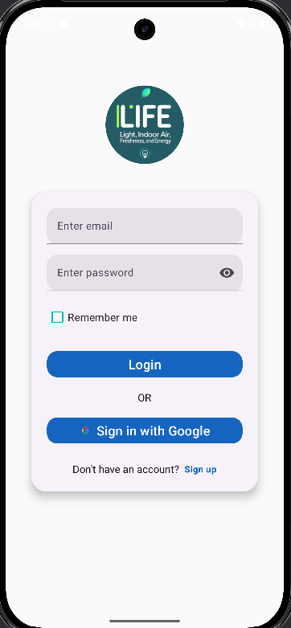
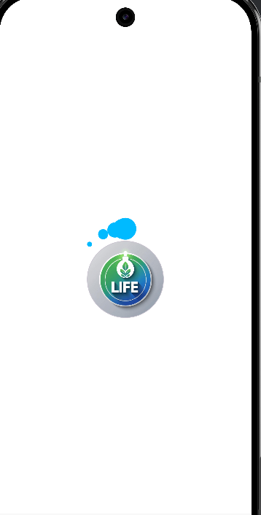
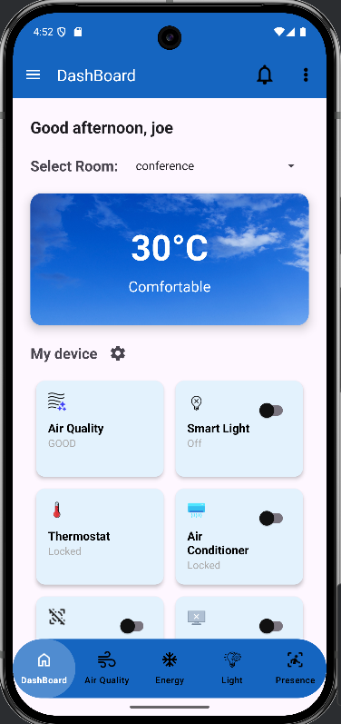
Screen Flow
Dashboard screen
Splash screen
Login screen

Slide 7
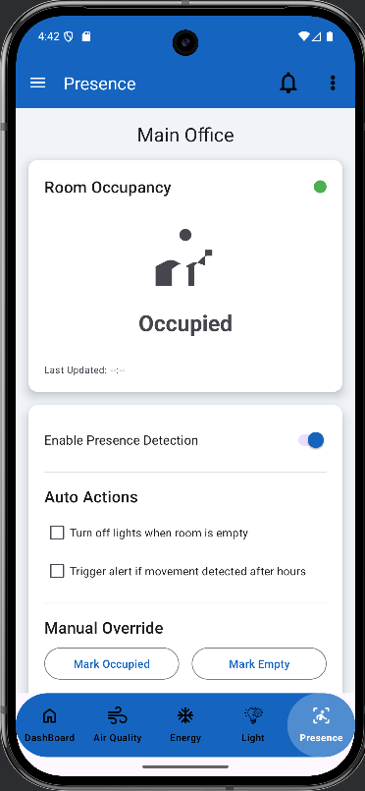
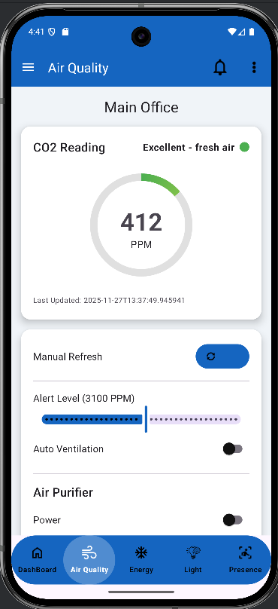
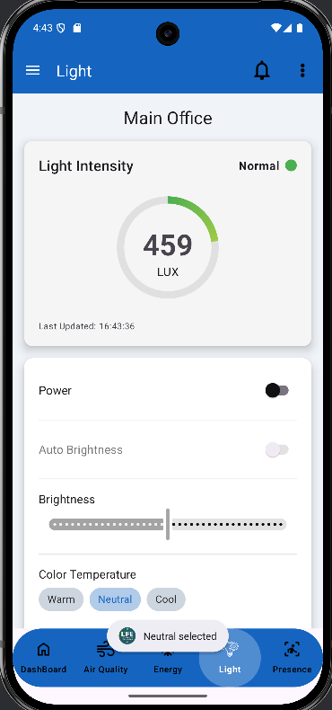
User Interface Showcase
Clean and Intuitive Design
The LIFE app features a user-friendly interface designed for seamless navigation, enabling users to easily monitor indoor environmental conditions and access key information effortlessly.

Slide 8

Database & Backend Integration
Seamless connectivity for accurate monitoring
The app utilizes Firebase for real-time updates, ensuring consistent data flow and storage. This integration allows for accurate monitoring and immediate user notifications, enhancing user experience and app reliability.

Slide 9
Analytics Integration
Firebase Analytics is crucial for understanding user engagement and app performance. It tracks essential usage patterns, providing insights into how users interact with the app. This data helps refine features and enhances user experience through:
Monitoring user session durations
Identifying popular app features
Collecting feedback for continuous improvement
By leveraging these insights, the LIFE Environmental Solutions app can evolve to better meet user needs, ensuring sustained engagement and satisfaction while promoting healthier indoor environments.

Slide 10
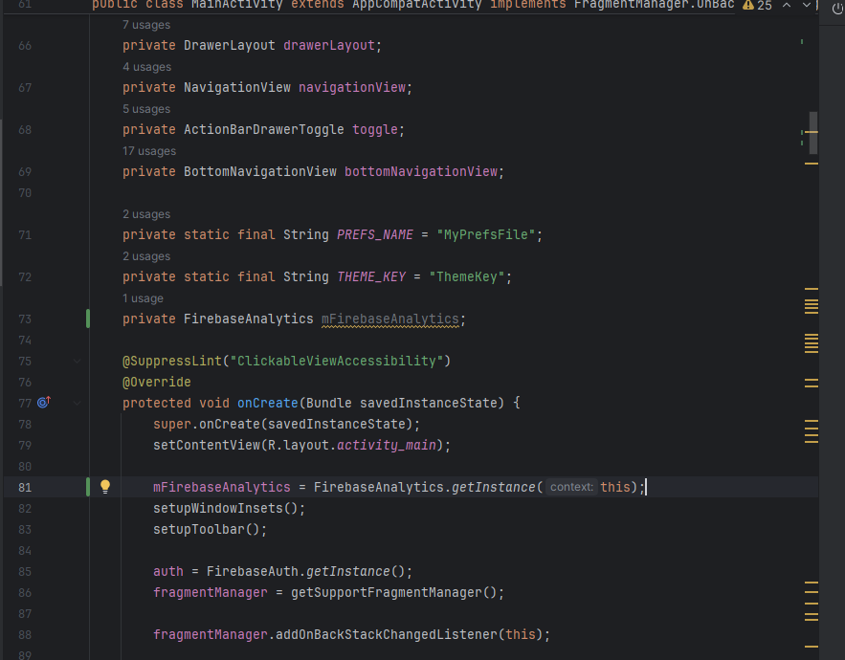
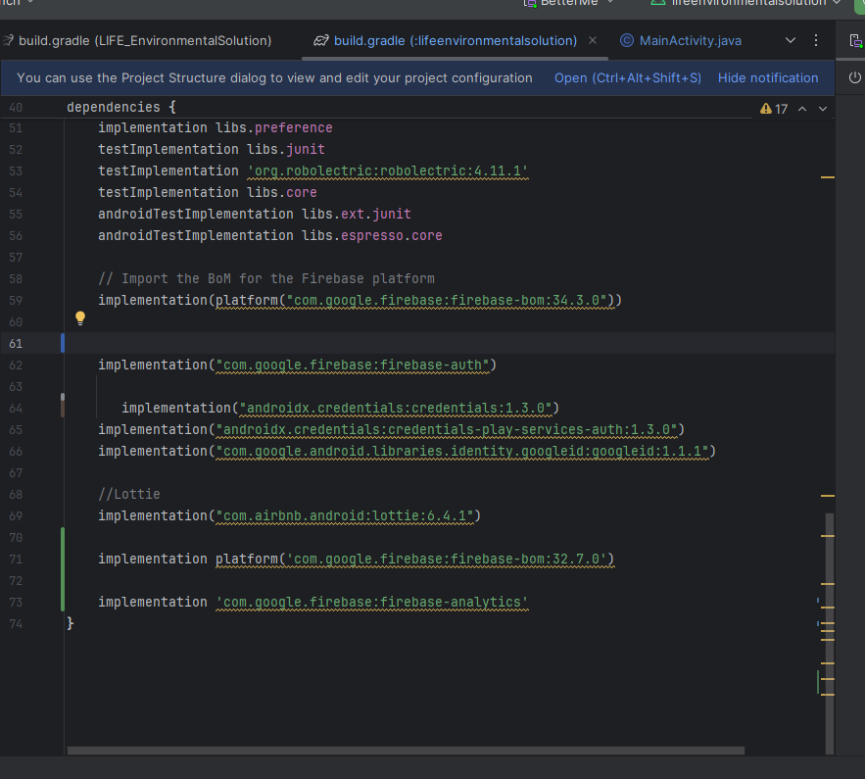
Analytics Integration

Slide 11
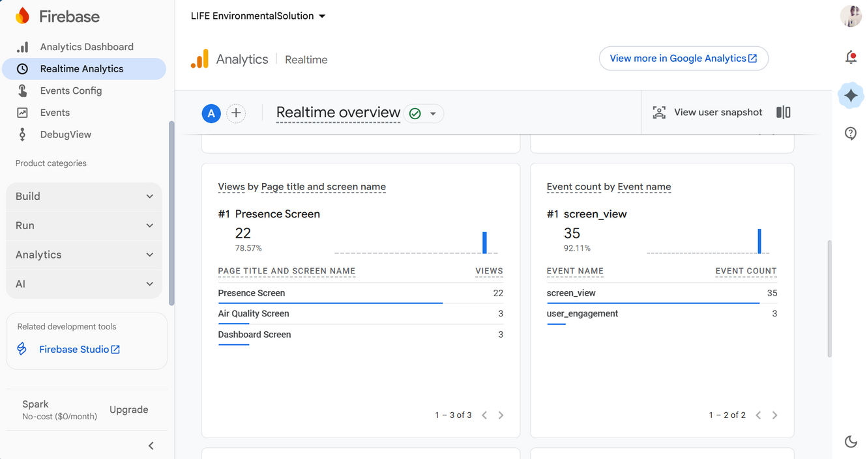
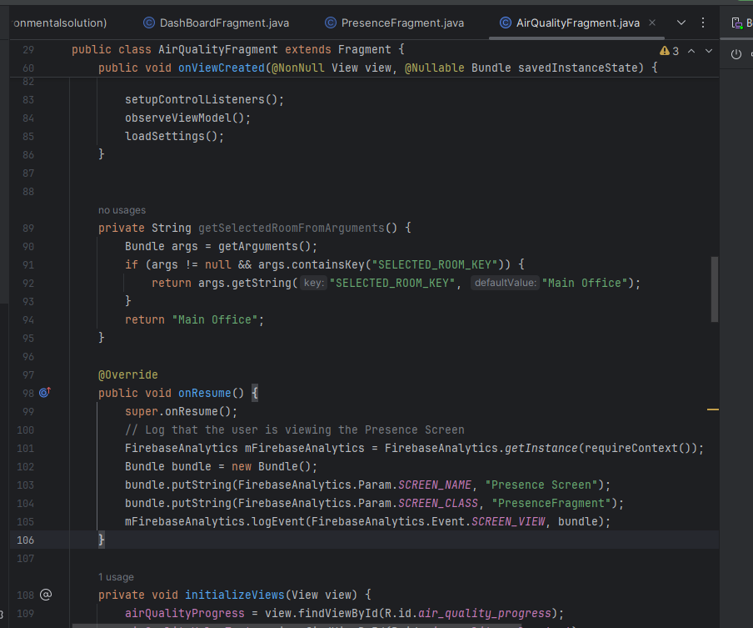
Analytics Integration

Slide 12
Testing & Quality Assurance
To ensure the highest standards of quality in the LIFE Environmental Solutions app, we implemented a comprehensive testing strategy:
JUnit Testing: Automated unit tests that validate the functionality of individual components, ensuring reliability.
Espresso Testing: UI testing framework for Android that guarantees user interfaces behave as intended, enhancing user experience.
Performance Monitoring: Ongoing tracking of app performance metrics to identify and rectify potential issues proactively.
Thorough QA Process: Continuous integration and deployment practices allow for timely detection of bugs and consistent app stability.

Slide 13
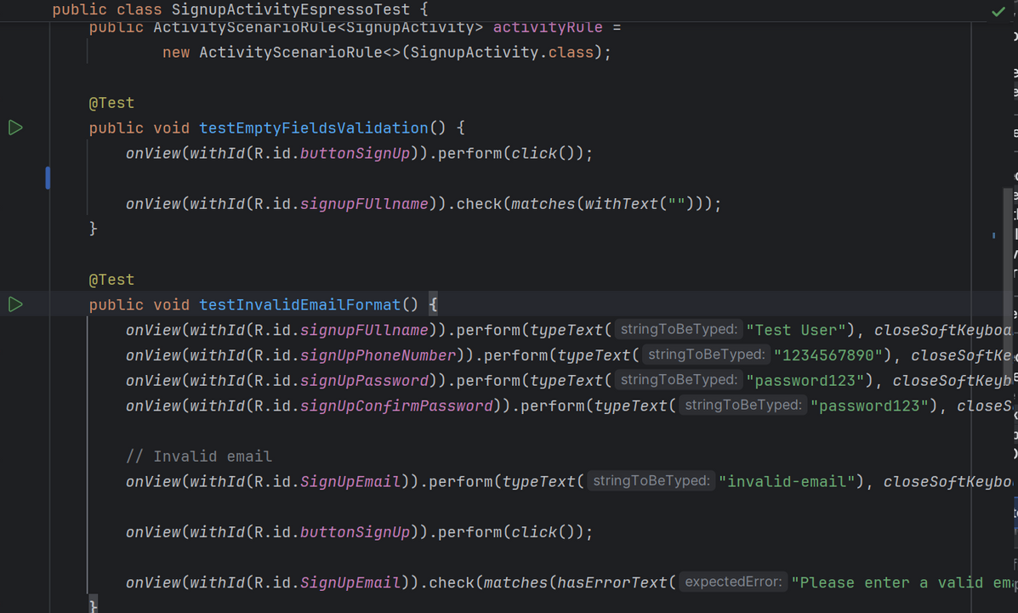
Testing & Quality Assurance

Slide 14

Future Enhancements
01
02
03
04
AI-driven alerts will provide proactive environmental management recommendations.
Smart home integration will enhance user control over indoor settings.
An advanced analytics dashboard will facilitate deeper insights for users.
Predictive models will optimize energy usage and indoor air quality.

